Slide 1
Theory of Automata
Lecture # 4-5-6

Slide 2
Recursive way and its examples
A recursive definition is fundamentally a three-step process:
We specify some basic objects in the set. The number of basic objects specified must be finite. This means that we write some basic facts about the set
Second, we give a finite number of basic rules for constructing more objects in the set from the ones we already know.
Finally, we provide declaration that no objects except those constructed in this way are allowed in the set.
Notes:
Initialization, process/rule and recursion

Slide 3
Recursive Definition examples
Defining language of INTEGER
Rule 1: 1 is in INTEGER.
Rule 2: If x is in INTEGER then x+1 and x-1 are also in INTEGER.
Rule 3: No strings except those constructed in above, are allowed to be in INTEGER.

Slide 4
Recursive Definition examples
Defining the language L, of strings beginning and ending in different letters , defined over Σ={a, b}
Rule 1: a and b are in L (ab, ba)
Rule 2: (a)s(b) and (b)s(a) are also in L, where s belongs to Σ*
Rule 3: No strings except those constructed in above, are allowed to be in L

Slide 5
Recursive Definition examples
Factorial Example
Lets consider the language of factorial:
Rule 1: We know that 0!=1, so 1 is in factorial.
Rule 2: Also n!=n*(n-1)! is in factorial.
Rule 3: Thus, no strings except those constructed in above, are allowed to be in factorial.

Slide 6
Recursive Definition examples
P-EVEN(positive even) is the set of all 2n, where n = 1, 2, . .
P-EVEN is defined by these three rules:
Rule 1: 2 is in P-EVEN.
Rule 2: If x is in P-EVEN, then so is x + 2.
Rule 3: The only elements in the set P-EVEN are those that can be produced from the two rules above.

Slide 7
Recursive Definition examples
We can make another definition for P-EVEN as follows:
Rule 1: 2 is in P-EVEN.
Rule 2: If x and y are both in P-EVEN, then x + y is in
P-EVEN.
Rule 3: No number is in P-EVEN unless it can be produced by rules 1 and 2.

Slide 8
Recursive Definition examples
A recursive definition for PALINDROME is as follows:
Rule 1: a and b are in PALINDROME.
Rule 2: If w is PALINDROME, then so are awa and bwb.
Rule 3: No other string is in PALINDROME unless it can be produced by rules 1 and 2.
Notes:
a is palindrome, b is palindrome

Slide 9
Regular Expressions
Regular expressions is a common means of defining a language.
RE is a set of symbols
The concept of RE was introduced in 1950s by the American mathematician Stephen Kleene
Notes:
RE is a sequence of characters that forms a search pattern, mainly for use in pattern matching with strings, or string matching, i.e. "find and replace"-like operations.

Slide 10
Regular Expressions
Useful operators used in the regular expression are as follows:
* = 0 or more
+ = 1 or more
a|b = a or b
(a|b)* = (a or b) 0 or more times
(a|b)⁺ = (a or b) 1 or more times
a|b* = a or b (only b 0 or more times)
(a|b)*(c|Λ) = (a or b) 0 or more times and c or Null string
Notes:
| Pipe symbol

Slide 11
Some more symbols
✓ abc… Letters
✓ 123… Digits
✓ \d any Digit
✓ . any Character
✓ \. Period
✓ [abc] Only a, b, or c
✓ [^abc] Not a, b, nor c
✓ [a-z] Characters a to z
✓ [0-9] Numbers 0 to 9

Slide 12
Some more symbols Cont…
✓ {m} m Repetitions
✓ * Zero or more repetitions
✓ + One or more repetitions
✓ ? Optional
✓ \s any Whitespace
✓ ^…$ Starts and ends
✓ ( ) capture Group
✓ (.*) capture Variable content
Notes:
? zero or one time only
^…$ i.e starting with blank and termination with $

Slide 13
Some more symbols Cont…
✓ (a|b) match's a or b
✓ \w any Alphanumeric character
✓ \W any Non-alphanumeric character
✓ \d any Digit
✓ \D any Non-digit character
✓ \s any Whitespace
✓ \S any Non-whitespace character
Notes:
Alphanumeric means combination of alphabets and numeric's

Slide 14
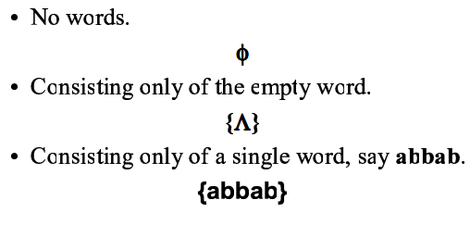
Small Language

Slide 15
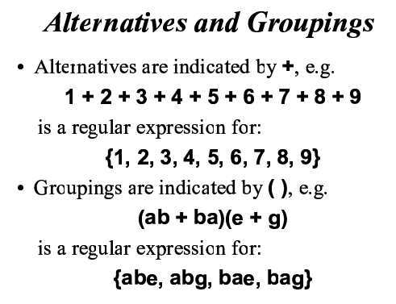
Alternatives and Groupings

Slide 16
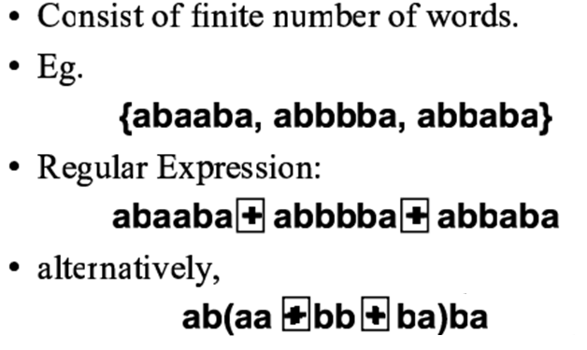
Finite Language

Slide 17
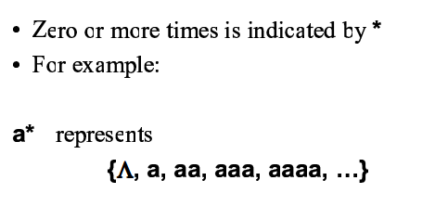
Kleene Star

Slide 18
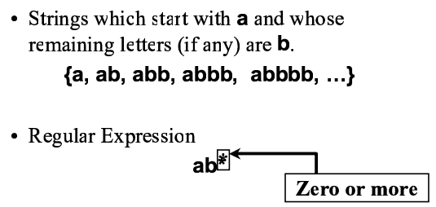
Some infinite languages

Slide 19
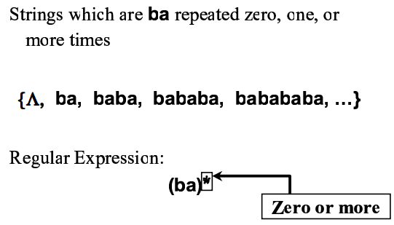
Some infinite languages

Slide 20
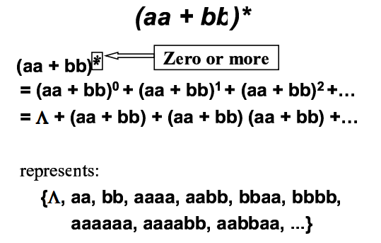
Some infinite languages

Slide 21
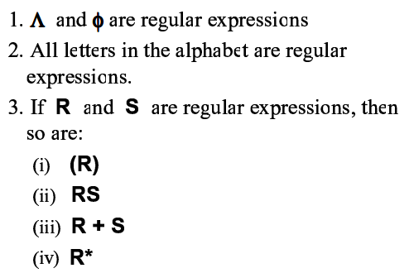
Definitions
Notes:
(R) is a subset

Slide 22
Definition of a Regular Expression
A regular expression may be the null string, r = λ
A regular expression may be an element of the input alphabet, r = a
A regular expression may be the union of two regular expressions, r = r1 + r2
A regular expression may be the concatenation of two regular expressions, r = r1 r2
A regular expression may be the Kleene closure (star) of a regular expression r = r1*
A regular expression may be a regular expression in parenthesis r = (r1)
Notes:
r⁺ is a subset of r*

Slide 23
Regular expression and output(set of strings)
RE - OUTPUT
λ - {λ}
λa= aλ - {a}
λ* - {λ}
a - { a }
aa - { aa }
a* - {λ, a, aa, aaa, ….}

Slide 24
Regular expression and output(set of strings)
RE - OUTPUT
aa* - { a, aa, aaa, ... }
a+ - { a, aa, aaa, ...}
ba+ - { ba, baa, baaa, ...}
(ba)+ - { ba, baba, bababa, ...}
(a|b) - { a, b }

Slide 25
Regular expression and output(set of strings)
RE - OUTPUT
a|b* - { a, λ, b, bb, bbb, ... }
(a|b)* - { λ, a, b, aa, ab, ba, bb, ... }
aa(ba)*bb - { aabb, aababb, aabababb, ... }
(a + a) - {a}
(a + b) - {a, b}

Slide 26
Regular expression and output(set of strings)
RE - OUTPUT
(a + b)² - (a + b)(a + b) = {aa, ab, ba, bb}
(a + b + c) - {a, b, c}
(a + b)* - {λ, a, b, aa, bb, ab, ba, aaa, bbb, aab, bba, ….}
(abc) - {abc}
(λ+ a) bc - {bc, abc}

Slide 27
Regular expression and output(set of strings)
RE - OUTPUT
ab* - {a, ab, abb, abbb, …}
(ab)* - {λ, ab, abab, ababab, …}
a + b* - {a,λ, b, bb, bbb, …}
a (a + b)* - {a, aa, ab, aaa, abb, aba, abaa, … }
(a + b)* a (a + b)* - {a, aaa, aab, baa, bab, …}

Slide 28
Regular expression and output(set of strings)
RE - OUTPUT
(a + λ)* - (a)* = {λ, a, aa, aaa, ….}
x* (a + b) + (a + b) - x* (a + b) = {a, b, xa,xb, ….}
(note: x* (a + b) + λ(a + b)), common)
x* y + y - x* y = {y, xy, xxy, ….}
(a + λ)* - (a)* = {λ, a, aa, aaa, ….}

Slide 29
Constructing Regular Expressions
start with a - a (a + b)*
end with b - (a + b)* b
start with a and end with b - a (a + b)*b
start with a or b - (a + b) (a + b)*
contains exactly 2 a's - (b)* a (b)* a (b)*

Slide 30
Constructing Regular Expressions
contains at least 2 a's
(a + b)* a (a + b)* a (a + b)*
contains at most 2 a's
b* a? b* a? b*
contains exactly 2 a's or 2 b's
[(b)* a (b)* a (b)*] + [(a)* b (a)* b (a)*)]
contains even no of a’s
[ (b)* a (b)* a (b)* ]*
with even length of a
(aa)+

Slide 31
Constructing Regular Expressions
Construct a regular expression for all words in which a appears thrice.
(aaa + b)*
or (b + aaa)*
etc

Slide 32
Constructing Regular Expressions
Construct a regular expression for all words that contain at least one of the strings s1, s2, s3, or s4
(s1 + s2 + s3 + s4)(s1 + s2 + s3 + s4)*
Notes:
For at most use ?

Slide 33
Constructing Regular Expressions
Construct a regular expression for all words that contain exactly two b’s or exactly three b’s, not more.
Start with bb+bbb then add possibility of other characters
a*ba*ba* + a*ba*ba*ba*

Slide 34
Constructing Regular Expressions
Construct a regular expression for all strings that end in a double letter.
(a + b)*(aa + bb)

Slide 35
Constructing Regular Expressions
Let r1, r2, and r3 be three regular expressions then
(r1+ r2)r3:
The first expression can be either r1 or r2.
The second expression is always r3.
There are two possibilities for this language: r1r3 or r2r3.
r1(r2 + r3):
The first expression is always r1.
It is followed by either r2 or r3.
There are two possibilities for this language: r1r2 or r1r3.

Slide 36
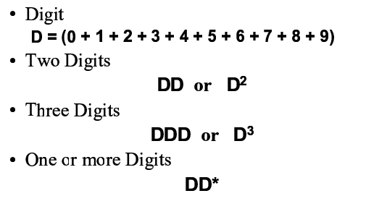
Sequence of Digits

Slide 37
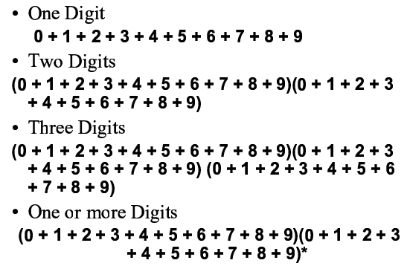
Sequence of Digits

Slide 38
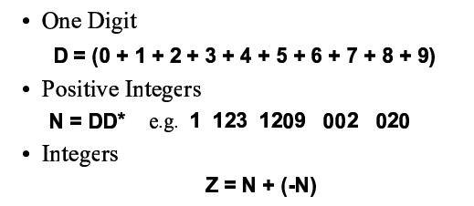
Numbers
Notes:
N is positive integer and –N is negative integer and + in between in for OR

Slide 39
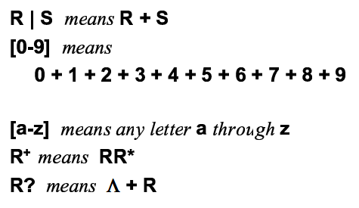
Other common notations
Notes:
R? is for optional mean zero or one (only)

Slide 40
Constructing Regular Expressions
∑ ={a, b}, Formally describe all words with a followed by any number of b’s
L = a b* = ab*
Give examples for words in L
{a ab abb abbb …..}

Slide 41
Constructing Regular Expressions
∑ ={a, b}, Formally describe the language that contains nothing or words starts with a where any a must be followed by one or more b’s
L = (abb*)*
Give examples for words in L
{Λ ab abb abababb …..}

Slide 42
Constructing Regular Expressions
∑ ={a, b}, Formally describe all words with a followed by one or more b’s
L = a b⁺ = abb*
Give examples for words in L
{ab abb abbb …..}

Slide 43
Constructing Regular Expressions
∑ ={a, b, c}, Formally describe all words that start with an a followed by any number of b’s and then end with c.
L = a b*c
Give examples for words in L
{ac abc abbc abbbc …..}

Slide 44
Constructing Regular Expressions
∑ ={a, b}, Formally describe all words where a’s if any come before b’s if any.
L = a* b*
Give examples for words in L
{Λ a b aa ab bb aaa abb abbb bbb…..}
NOTE: a* b* ≠ (ab)*
because first language does not contain abab but second language has.
Once single b is detected then no a‘s can be added

Slide 45
Constructing Regular Expressions
∑ ={a}, Formally describe all words where count of a is odd.
L = a(aa)* OR (aa)*a
Give examples for words in L
{a aaa aaaaa …..}

Slide 46
Constructing Regular Expressions
∑ ={a, b, c}, Formally describe all words where single a or c comes in the start then odd number of b’s.
L = (a+c)b(bb)*
Give examples for words in L
{ab cb abbb cbbb …..}

Slide 47
Constructing Regular Expressions
∑ ={a, b, c}, Formally describe all words where single a or c comes in the start then odd number of b’s in case of a and zero or even number of b’s in case of c .
L = ab(bb)* +c(bb)*
Give examples for words in L
{ab c abbb cbb abbbbb …..}

Slide 48
Constructing Regular Expressions
∑ ={a, b, c}, Formally describe all words where one or more a or one or more c comes in the start then one or more b’s.
L = (a+c) ⁺ b⁺= (aa*+cc*) bb*
=(a ⁺ +c ⁺) b⁺
=(a +c ) (a +c )* bb*
=a⁺b⁺|c⁺b⁺
Give examples for words in L
{ab cb aabb cbbb …..}

Slide 49
Constructing Regular Expressions
∑ ={a, b}, Formally describe all words with length three.
L = (a+b) ³ =(a+b) (a+b) (a+b)
List all words in L
{aaa aab aba baa abb bab bba bbb}
What is the count of words of length 4?
16 = 2⁴
What is the count of words of length 44?
2⁴⁴

Slide 50
Constructing Regular Expressions
Suppose
∑ ={a, b}, What does L describe?
L = (a+b)* a(a+b) *
Any string of a's and b's
Any string of a's and b's
Single a
A Language that contains at least one a
Give examples for words in L
{a ab aab bab abb …..}

Slide 51
Constructing Regular Expressions
Suppose
∑ ={a, b}
Formally describe all words with exactly two a's.
L = b*ab*ab*
Give examples for words in L
{aab, baba, and bbbabbbab …..}

Slide 52
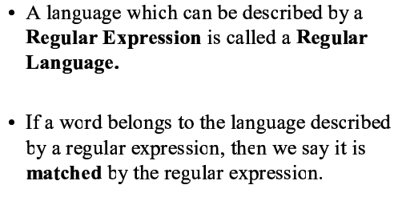
Regular Language

